Slide 1
Echo-Messager
Guided By Mrs.R.Anitha AP/CSE
BY:
V. Kirthick Sakthi(21CS046)
S. Kaleeswaran (21CS041)
A. Joshin Singh (23RCS01)

Slide 2
OBJECTIVE
Create a Echo messaging app that makes it easy for people to chat, share Group, and connect with friends and family.
Our goal is to provide a secure and user-friendly platform, ensuring that everyone can enjoy instant communication and stay connected effortlessly.
Capability to send and receive various types of emoji, including messages.

Slide 3
FEATURES
Robust security measures to ensure the privacy and confidentiality of user conversations.
Enhanced Additional privacy settings, such as the ability to control who can see when a user is online or the option to go "invisible" in specific chats.
The ability to send messages even when offline,with messages delivered once the user is back online.

Slide 4
ABSTRACT
Provide users experience.Chat communication,
with a seamless
and intuitive
messaging
application is a connecting users
versatile
worldwide in real-time
platform for
conversations. With a user-friendly interface, sending messages
and sharing emojis,
and engaging in group chats is
effortless.Implement a straight
forward account creation process
and a secure login system for user authentication.The Echo Messaging Application is a user-centric communication platform designed to redefine the way individuals connect and interact.

Slide 5
LITERATURE SURVEY
Title | Author | Year | Journal Name | Merits | Limitations
Interface Design | Alan Dix, Janet Finlay, Gregory D. Abowd, Russell Beale | 2023 | Mobile Human- Computer Interaction Journal | Instant Communication | The echo messaging can lead to distractions
The Rise of Echo Messaging | Dan Jurafsky, James H. Martin | 2022 | Wiley Social Platform | Enhanced Connectivity | Leading to feelings of loneliness.
A Comprehensive Survey of Echo Messaging Applications | Dr. Michael Smith | 2021 | Pearson Education | Integration with Other Tools | Privacy Concerns And Distraction
Evolution and Social Implications | Ross Anderson | 2020 | International Journal of Communication Systems | Enhanced Privacy Features | Digital Fatigue And misuse the data

Slide 6
EXISTING SYSTEM
Existing systems provide users with diverse options for echo messaging across different contexts, platforms, and user preferences.
The platform's anonymous chat feature allows users to engage in conversations revealing their identities, promoting open dialogue while preserving privacy.
Lack of Support: Older chat applications may no longer be supported by their developers, meaning users may not receive updates, bug fixes, or technical support, leaving them vulnerable to security threats and usability issues.

Slide 7
PROPOSED SYSTEM
All your data will be stored on the database so that they can be restored once you login again.
Implement an AI-driven smart reply system and secure, login system and Sign up System for user authentication.
You can search for others who using this web app,you can
create groups and you can add or remove members from
group.

Slide 8
METHODOLOGY
The MERN stack is a robust and popular technology stack used for building modern, full-stack web applications.
The Google Authentication and Firebase has been Used.
Hosting – Netifly,Gitpages.
Develop backend infrastructure for message storage, retrieval, and delivery.

Slide 9
Work Flow
Frontend (React): Develop dynamic user interfaces and manage client-side logic using React components.
Backend (Node.js with Express.js): Implement server-side logic and manage HTTP requests and responses using Node.js with the Express.js framework.
Database (MongoDB): Store and retrieve data using MongoDB, a flexible NoSQL database suitable for web applications with evolving data structures.

Slide 10
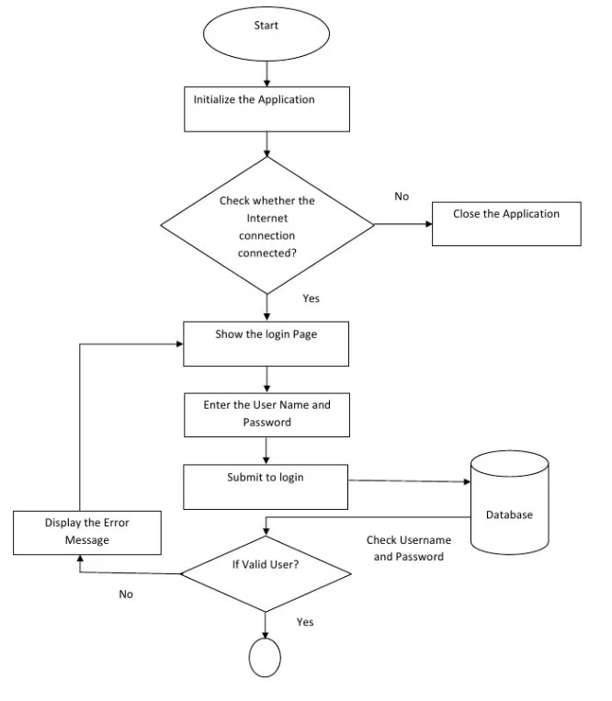
FLOW DIAGRAM

Slide 11
MODULE
Storage Module
User Interface Module

Slide 12
Storage Module
The storage module in the Echo messaging application plays a vital role in ensuring the reliability, security, and scalability functionality of the platform.
The storage module is responsible for securely storing user messages in a database.
The storage module, with measures such as encryption implemented to protect user data from unauthorized access.

Slide 13
User Interface Module
Users can personalize their profiles with display names, profile pictures, and status updates. Avatars and profile details are prominently displayed within your name for easy identification.
Users have access to a settings interface where they can customize profile preferences, login and signup interface, and other application-specific settings. This module ensures a personalized and adaptable user experience.

Slide 14
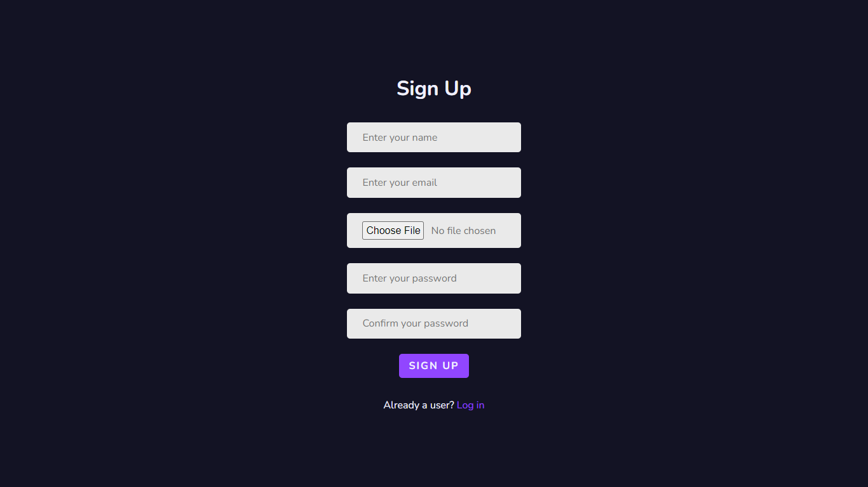
OUTPUT

Slide 15
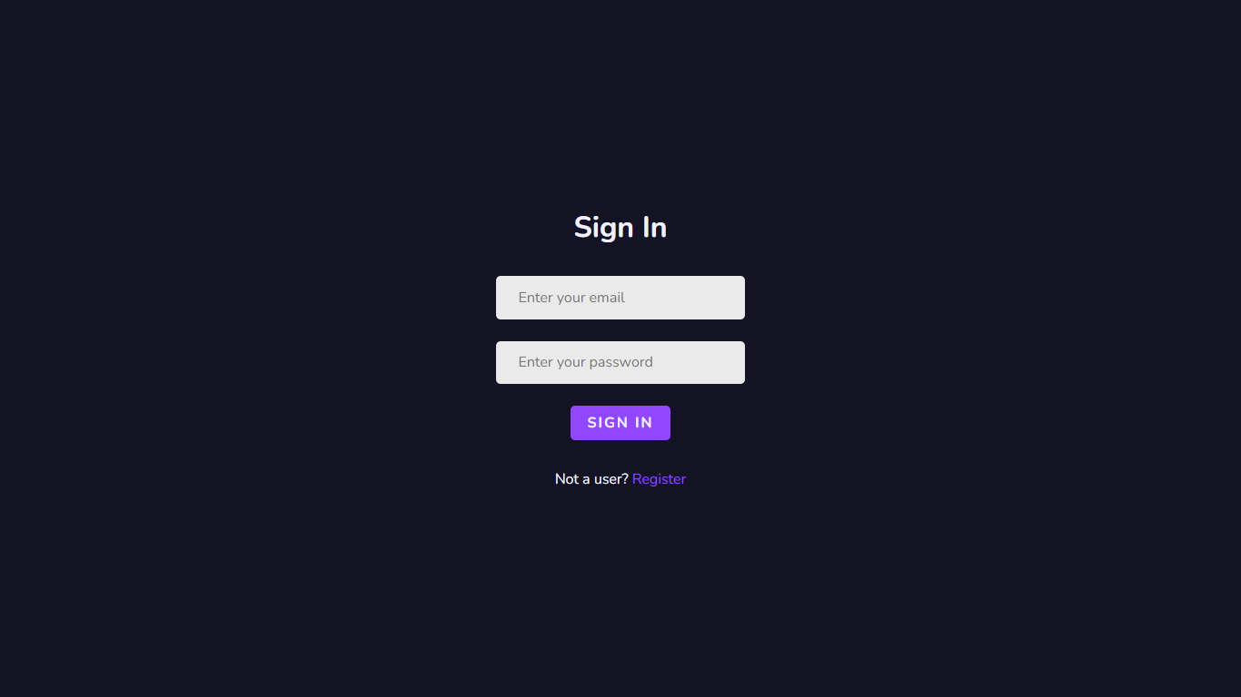
OUTPUT

Slide 16
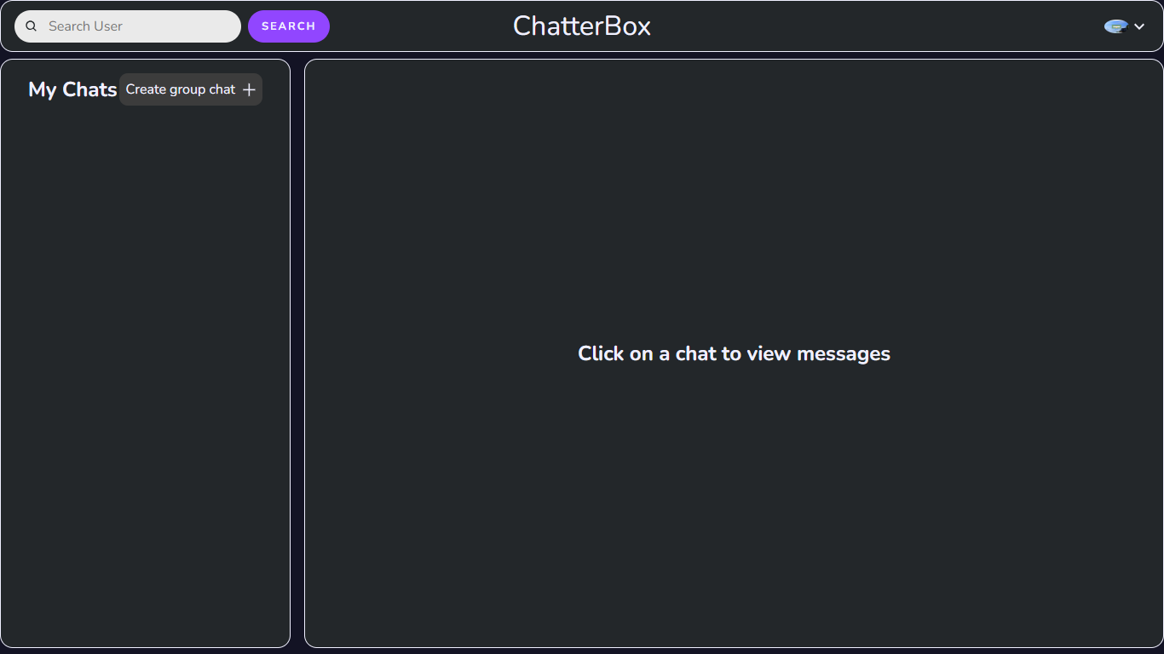
OUTPUT

Slide 17
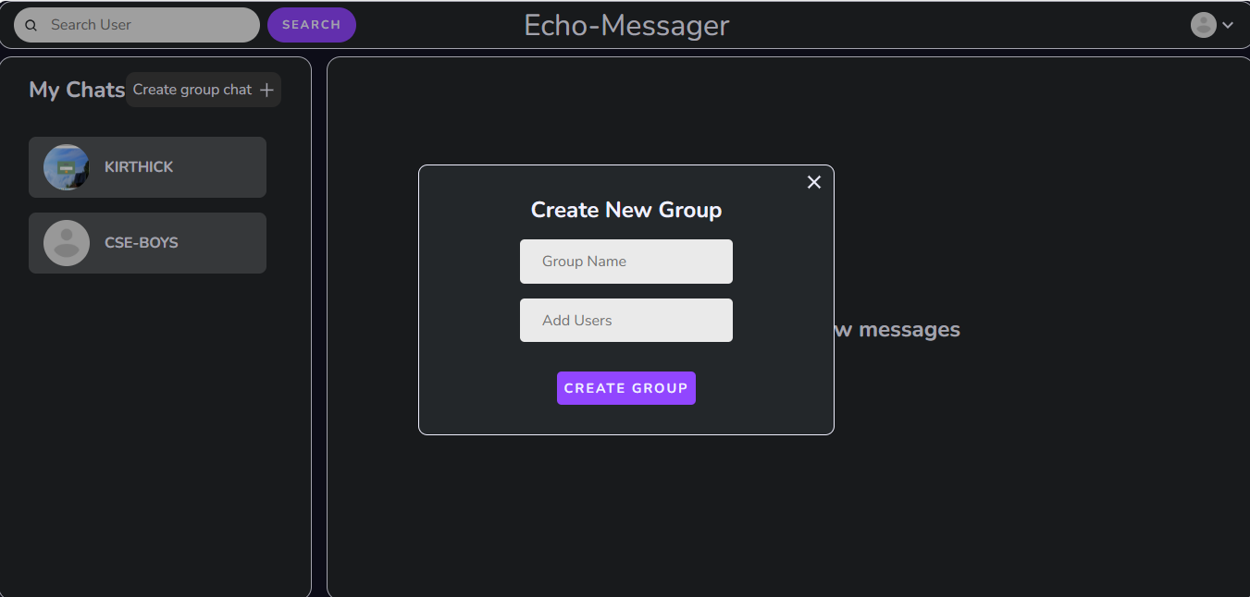
OUTPUT

Slide 18
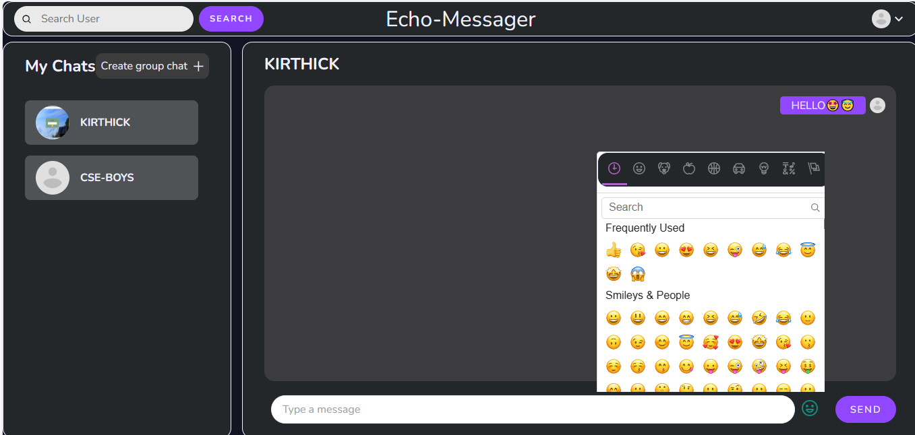
OUTPUT

Slide 19
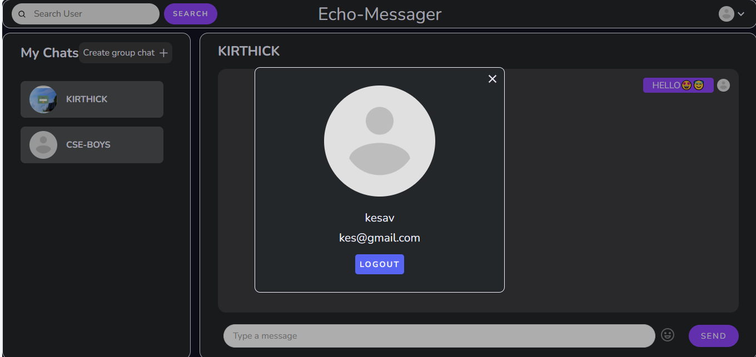
OUTPUT

Slide 20
CONCLUSION
Echo Messaging redefines communication with its advanced features like end-to-end encryption and anonymous chat. Our platform prioritizes user privacy and security, ensuring every interaction is safe and confidential. Whether connecting with friends or colleagues, Echo Messaging provides a seamless and intuitive experience. Join us today to experience the freedom of authentic conversations without compromise.

Slide 21
REFERENCE
Interface Design, Alan Dix, Janet Finlay, Gregory
D.Abowd 2023, Mobile Human Computer Interaction Journal.
  The Mobile Human-Computer Interaction Journal, IEEE Access Volume 8, Dan Jurafsky,James H. Martin,2022, Wiley Social Platform.
  A Comprehensive Survey of Echo Messaging Applications, Dr. Michael Smith,2021, Pearson Education.
  Evolution and Social Implications, Ross Anderson,2020,IEEE Xplore Volume15,International Journal of Communication.

